Slide 1

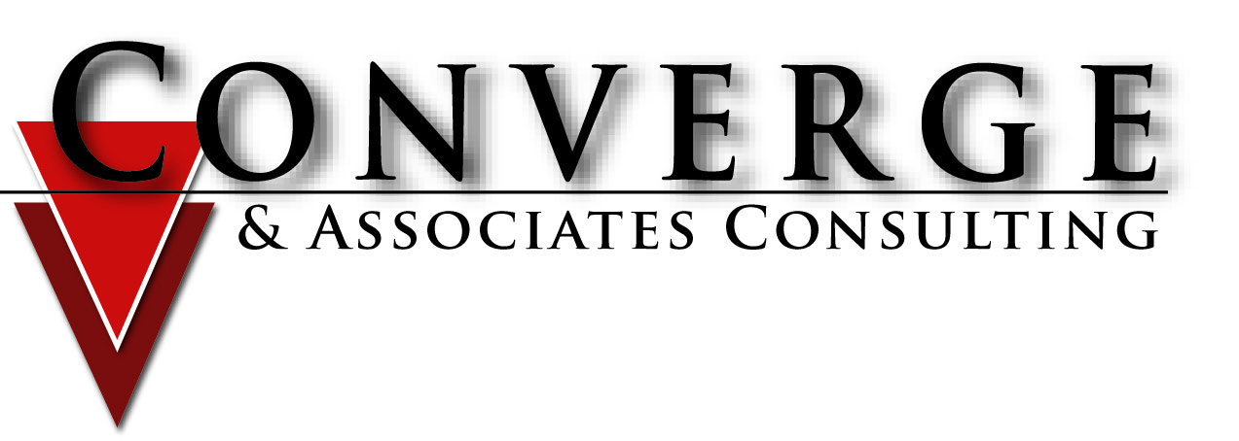
Conflict in the Workplace
Management in a Culturally Diverse Environment
Barbara I. Cheives
Notes:
Conflict is a subject many of us are not comfortable with….in fact, most of us will go out of our way to avoid conflict. Let me ask you, is conflict good or bad?
(some folks will say “bad”…at least one may say “it can be good depending on how things turn out”) The truth is that conflict is neither good nor bad…it’s a matter of fact. It’s a difference in opinions, beliefs, or values. It’s not the conflict itself….it’s how we RESPOND in the conflict that puts off most of us….not knowing how “the other” will respond---or maybe in some cases---not knowing how WE’LL respond if people behave in a certain way ☺ And of course there are those folks who seem to thrive on conflict and may personally generate a lot of it in the workplace, or in our families—and they fall into a special category ☺Everyone faces conflict in their lives on a daily basis. It is an accepted and expected part of life.

Slide 2
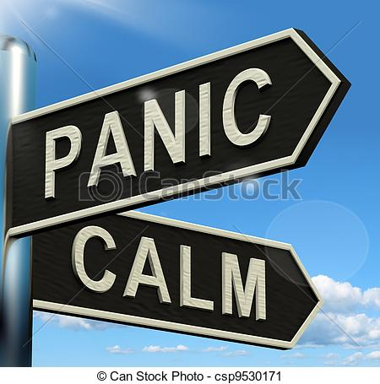
The ultimate measure of a man is not where he stands
in moments of comfort and convenience, but where
he stands at times of challenge and controversy.
Martin Luther King, Jr.

Slide 3

CONFLICT
noun \ˈkän-ˌflikt\
: a struggle for power, property, etc.
: strong disagreement between people, groups, etc., that results in often angry argument
: a difference that prevents agreement : disagreement between ideas, feelings, etc.
Merriam Webster

Slide 4

Answer two questions…..
1) What messages did you learn about conflict growing up?
2) Is your current style of managing conflict similar to or different from what you observed/experienced growing up and why do you think that is?
Notes:
We all come with our own “stuff” around conflict and it’s important that we look at the “stuff”
Believe it or not, that STUFF started early
Loud
Direct
Quiet
Denial

Slide 5
Conflict is like a….
Notes:
In pairs or small groups….review the Conflict is Like a …Handout and select one description that most closely fits your idea of conflict and why.
Then reflect upon the choices and consider how your organization tends to view and deal with conflict…share the “why” or your perception of why…Comment on the diversity of descriptions from individuals…especially where individual descriptions are one thing and organizational descriptions are another. The selections of individual and organizational descriptions are based on people’s perceptions…perceptions, in fact, can often drive not only how one views conflict…
What we see depends upon where we stand so to speak. Take a look at the following slides and tell me what you “see”.

Slide 6
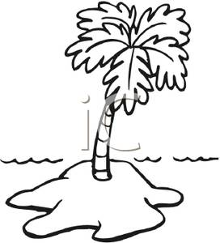




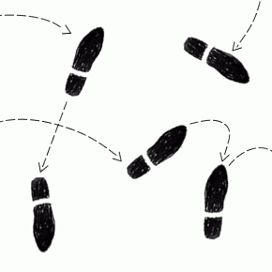
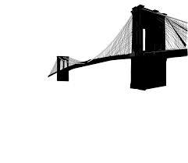





SYMPHONY
DESERTED ISLAND
MASK
BOXING MATCH
SUNRISE
BRIDGE
PUZZLE
DANCE
DREAM
CACTUS PLANT
STORM
STORM

Slide 7
Common Contributors to Conflict at Work
Ambiguous roles and responsibilities
Assumptions and expectations
Core values not being met
Differing personal lenses and filters through which co-workers interpret the world
Emotions hijacking conversations
Group dynamics such as gossip and cliques
Miscommunication or vague language
Notes:
Common Contributors to Conflict at Work
When you’re dealing with conflict in the workplace, consider the underlying causes. Conflict is rarely as simple as it seems on the surface. Problems at work are often caused — or exacerbated — by the following:
Ambiguous roles and responsibilities: Being vague with an employee about his job and the tasks associated with his duties creates a situation in which he’s left to decode your expectations. Create clear directives that include who, what, when, where, and why so he doesn’t trip over his co-workers just trying to get his job done.
Assumptions and expectations: Ask open-ended questions to see whether an employee is filling in details based on his past experiences (both on the job and in his personal life) or whether he’s seeing something you’re not.
Core values not being met: Rarely is a disagreement about surface issues. Determine what’s most important to an employee by uncovering his values. Use the insight to help him create long-lasting solutions based on what will satisfy all parties involved.
Differing personal lenses and filters through which co-workers interpret the world: Recognize that all members of your staff have individual lenses and filters through which they see and respond to their environments — and no two are the same. Deciphering the code and seeing things from their perspectives give you a new way to understand and approach problems.
Emotions hijacking conversations: When emotions are high, reasoning is low. Let things calm down, and then approach employees to discover what caused the reaction in the first place.
Group dynamics such as gossip and cliques: Cliques form in the workplace for a number of reasons, but whatever the motivation employees have for attaching themselves to co-workers, the attachment has both positive and negative repercussions. Use positive group momentum to your advantage and equalize the power when needed.
Miscommunication or vague language: Say what you mean and mean what you say. Avoid using language like “when you get to it” and “whatever you think.” Leaving things to an employee’s imagination can make for some pretty imaginative interpretations.
We See & Hear things differently – Subway Story

Slide 8

Culture & Conflict…………
Our Culture forms our view of the world…..

Slide 9
Demographics
We’re becoming an increasingly diverse society
This diversity means that many different cultures operate in our communities.
The people that we work with represent an amazing array of diversity and cultural richness
Decker, Decker & Brown, 2007
Notes:
Often culture is at the root of conflict
9

Slide 10

Diversity & Cultural Differences
Ethnic Group, Race or Color
National Origin
Gender
Age
Religion
Mental/Physical Ability
Sexual Orientation and Gender Identity
Family/Marital Status
……..within each community
Notes:
Transgender

Slide 11
The (negative) impact of personal culture on communication
  Incorrect assumptions about the other
  Language and communication style issues
  Biases against the unfamiliar
  Personal values in conflict
  Expectations that others will conform to established norms
        Adapted from Selma Myers
        Conflict and Culture

Slide 12
Organizational Culture………….
The integrated pattern of human behavior that includes thoughts, communication styles, actions, customs, beliefs, values and institutions to ensure that the needs of our employees are met within the context of their culturally informed world view.
Notes:
Speaking of established Norms – Each of your organizations has a distinct culture of its own

Slide 13

Determining Conflict Style

Slide 14


What is Your Conflict Style?

Slide 15
Five Conflict-Handling Modes
Competing
Collaborating
Compromising
Assertiveness
Avoiding
Accommodating
Cooperativeness
Notes:
There are 5 basic types of conflict styles
A good way to describe these positions is in terms of
How much we are trying to satisfy ourselves – Assertiveness
Or How much we are trying to satisfy others – Cooperativeness
At the point where we are the most unassertive and the most uncooperative, we are actually AVOIDING the conflict. When we avoid, our position is not a position. When avoiding we make little or no attempt to satisfy our own needs. When both parties avoid, you are at a stalemate and end up with anger and frustration.
If we are cooperative with no attention to our own concerns, we become ACCOMODATING. When we are accommodating, we make a real attempt at satisfying the other person’s concerns and making little or no attempt at satisfying our own concerns. We are being cooperative but unassertive.
When we become overly assertive and less cooperative, then we become COMPETING. While attempting to satisfy our own concerns, we should little regard for others. If both parties are committed to holding on to their own positions, it becomes impossible for them, or anyone else, to devise a way out. Competing is a classic conflict situation.
When we are being mildly assertive and mildly cooperative, it’s call COMPROMISING. When we compromise, we agree to give up half of what we want in order to get the other half. We call that ‘Splitting the Difference”.
Accommodating, Competing & Compromising, have one thing in common – the parties are never really satisfied – there is only partial satisfaction for one or both of the parties.
There is one last position that you can take in a conflict. It requires the most patience and commitment to achieve, but produces the best and most lasting result and when successful, you completely satisfy the desires of both parties – COLLABORATING – It is being highly cooperative about our own concerns, but highly cooperative to the others. Requires a willingness to look past people’s positions to uncover the concerns that underlie those positions. You have to put aside the friction to find out what you both really want.
For collaborating to work, you must engage in active listening and communicate honestly and openly. You have to be highly assertive to your own concerns and highly cooperative to the concerns of the other.
Collaboration defines conflict as a mutual problem and allows us to work toward a positive outcome. In order for it to work,, both parties must continue to be committed to the process. Collaboration is very important in an organization where both concerns that you are talking about are too important to be sacrificed.

Slide 16

Try on Another Style For Size
Notes:
Knowing all of these styles and how and when to use them allows you to manage the conflict more constructively.

Slide 17

How Does Nonverbal Communication Impact Interactions?
Wordless communication, or body language, includes facial expressions, body movement and gestures, eye contact, posture, the tone of your voice, and even your muscle tension and breathing. The way you look, listen, move, and react to another person tells them more about how you’re feeling than words alone ever can.

Slide 18

Effective Communication……
Effective communication helps us better understand a person or situation and enables us to resolve differences, build trust and respect, and create environments where creative ideas, problem solving and effectiveness can flourish.

Slide 19
Conflict Resolution Triangle
Relationships
Issues
Emotions
Notes:
Too often we go right to the issue….when the relationship and emotions should be addressed first….
So there are two students and only one available computer terminal – Both students stake claim and both are upset..
”I know you’re a conscientious student, and it’s clear this situation is upsetting to you.

Slide 20

The “I” Statements………….
I want…..
I feel
I would appreciate it if
I think
I need
I understood you to say
It was my understanding that…
I guess I misheard. Please….
Perhaps I wasn’t clear…I’d like….

Slide 21
Three Steps to Resolve Conflict
STEP ONE:
Agree on the Specific Conflict – Go Directly to the Source
  Use active listening skills
  Each side presents point of view
  Listen with empathy
  Use “I” statements, not you statements
  Each side states which behaviors must be changed to resolve the conflict
  Each side shares positive statements about the other
  Both sides mutually agree on the specific conflict
Notes:
These Three steps can be used if you are the one engaged in conflict or if you are mediating a conflict
First, go directly to the source. That may be another individual in conflict with you or it may be two of your employees in conflict with each other. Whatever the situation – remain impartial. If someone is in conflict with you – hear them out. The issue may have nothing at all to do with work – it could just be stress in their outside life that they’ve brought to work. Or they may have a legitimate case to be in conflict with you – and you must be open to the fact that you could be the one who is in the wrong. And if the conflict is between two of your employees – go to each separately and discuss it with them.

Slide 22
Three Steps to Resolve Conflict
STEP TWO:
Brainstorm possible solutions – Bring the Parties Together
  What would it take to resolve the conflict?
  What would each side have to do differently?
  Be open to new ideas, including ones never considered
Notes:
#2 – Bring parties together to discuss
Once you’ve heard each side separately, bring them together for a monitored discussion. The key is to work through the issues – together. You need to get to the root of the issue so that it doesn’t become bigger and threaten the work being done or the cohesiveness of the small workplace environment.

Slide 23
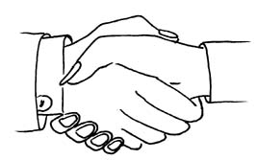
Three Steps to Resolve Conflict
STEP THREE: Come to a Resolution - Select the best solution
  Win/Win
  Win/Lose
  Lose/Win
  Lose/Lose
Notes:
When we are in conflict, we have choices,
# 3 – Come to a resolution
Finally, you must come to some resolution – even if it just involves more discussion and a shaking of hands. Or in my case it would need to involve pizza. If you can get the parties to shake hands, smile, and put it behind them then the battle has been won and you can move on.
Don’t be afraid to look into the conflict in detail, if necessary. If new policies or procedures need to be put in place to avoid the same conflict arising in the future, have that discussion with your employees. The more you let them have ownership of the situation and the necessary changes that are going to be implemented, the more they will actually comply with those new policies and procedures.

Slide 24
Fair Fighting Ground Rules
Remain calm
Express feelings in words not actions
Be specific about the issues
Deal with only one issue at a time
No hitting below the belt
Avoid Accusations
Notes:
If you are mediating you must see that both sides play by the rules

Slide 25
Fair Fighting Ground Rules
Try not to generalize
Avoid make believe
Don’t stockpile
Avoid clamming up
Establish additional common ground rules

Slide 26
Signs That Conflict at Work Is Subsiding
Have relaxed conversations and interactions
Cooperate on tasks and projects
Change their word choices (for example, “them” becomes “us”)
Reduce their gossip
Improve their tone of voice and relax their body language
Keep their agreements
Display a willingness to address new problems
Notes:
When you’re attempting to resolve conflict in the workplace, you want to see signs that the situation is starting to improve. Your mediation strategies are working when you begin to notice that your employees

Slide 27
Keeping The Peace
Keep an eye on the situation
Pick your battles
Understand the WIIFM factor
Correct the Problems from your level
Create team building opportunities
Take corrective action when necessary
Notes:
Understanding the WIIFM Factor: Understanding the other professionals WIIFM (What’s In It For Me) position is critical. It is absolutely essential to understand other’s motivations prior to weighing in. The way to avoid conflict is to help those around you achieve their objectives. If you approach conflict from the perspective of taking the action that will help others best achieve their goals you will find few obstacles will stand in your way with regard to resolving conflict.
4. The Importance Factor: Pick your battles and avoid conflict for the sake of conflict. However if the issue is important enough to create a conflict then it is surely important enough to resolve. If the issue, circumstance, or situation is important enough, and there is enough at stake, people will do what is necessary to open lines of communication and close positional and/or philosophical gaps.
View Conflict as Opportunity: Hidden within virtually every conflict is the potential for a tremendous teaching/learning opportunity. Where there is disagreement there is an inherent potential for growth and development. If you’re a CEO who doesn’t leverage conflict for team building and leadership development purposes you’re missing a great opportunity. Divergent positions addressed properly can stimulate innovation and learning in ways like minds can’t even imagine. Smart leaders look for the upside in all differing opinions.
Bottom line…I believe resolution can normally be found with conflicts where there is a sincere desire to do so. Turning the other cheek, compromise, forgiveness, compassion, empathy, finding common ground, being an active listener, service above self, and numerous other approaches will always allow one to be successful in building rapport if the underlying desire is strong enough. However, when all else fails and positional gaps cannot be closed, resolve the issue not by playing favorites, but by doing the right thing.

Slide 28

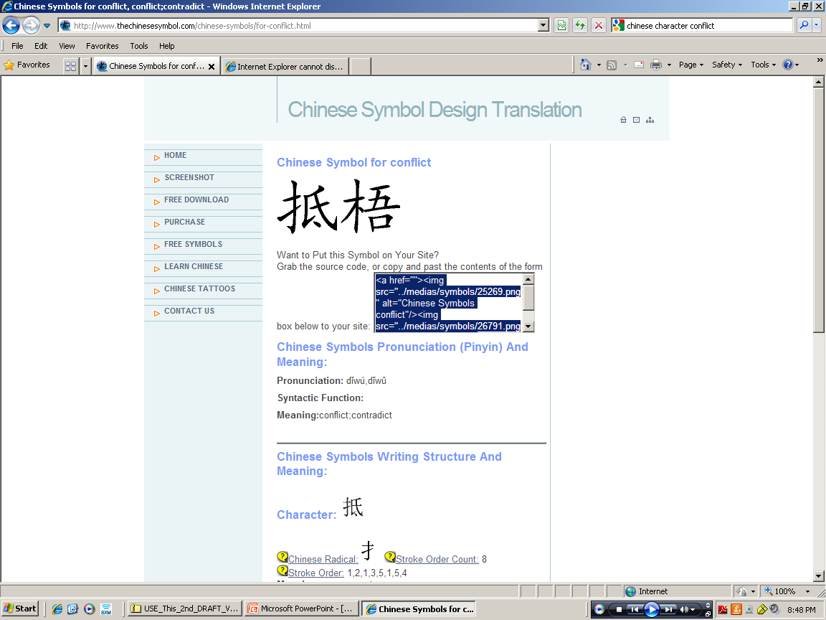
In the End…………………
Conflict ; Chaos; Danger =
Opportunity
Notes:
Summary
Conflict can be a good thing. And it can be a very damaging thing if it’s not handled promptly and properly. Never make the mistake of taking your employees’ issues too lightly. Make sure they understand that their concerns are important to you and that you have their best interests in mind as you work to help resolve these workplace conflicts. By doing so, you show them that you’re in charge but you care about them and that they are a vital part of your organization.
View Conflict as Opportunity: Hidden within virtually every conflict is the potential for a tremendous teaching/learning opportunity. Where there is disagreement there is an inherent potential for growth and development. If you’re a CEO who doesn’t leverage conflict for team building and leadership development purposes you’re missing a great opportunity. Divergent positions addressed properly can stimulate innovation and learning in ways like minds can’t even imagine. Smart leaders look for the upside in all differing opinions.
Bottom line…I believe resolution can normally be found with conflicts where there is a sincere desire to do so. Turning the other cheek, compromise, forgiveness, compassion, empathy, finding common ground, being an active listener, service above self, and numerous other approaches will always allow one to be successful in building rapport if the underlying desire is strong enough. However, when all else fails and positional gaps cannot be closed, resolve the issue not by playing favorites, but by doing the right thing.

Slide 29

Thank You For Participating !!!
Barbara I. Cheives
Converge & Associates Consulting
1977 Brandywine Rd. Suite 203
West Palm Beach, FL 33409
barbara@convergeandassociates.com
(office) 561-689-2428
(cellular) 561-351-6864

